Slide 1
SYSTEM REQUIREMENT
Software Specification
Language : JAVA, HTML, CSS.
Framework : Spring, Bootstrap.
Database : MySQL
Operating System : Windows 10
Server : : Apache Tomcat(9.0.1)

Slide 2
Hardware Specification
Processor : Intel i3/i5/i7
Processor Speed : 2.9 GHZ
RAM : 4 GB to 8 GB
Hard Disk : 10 GB to 180 GB

Slide 3
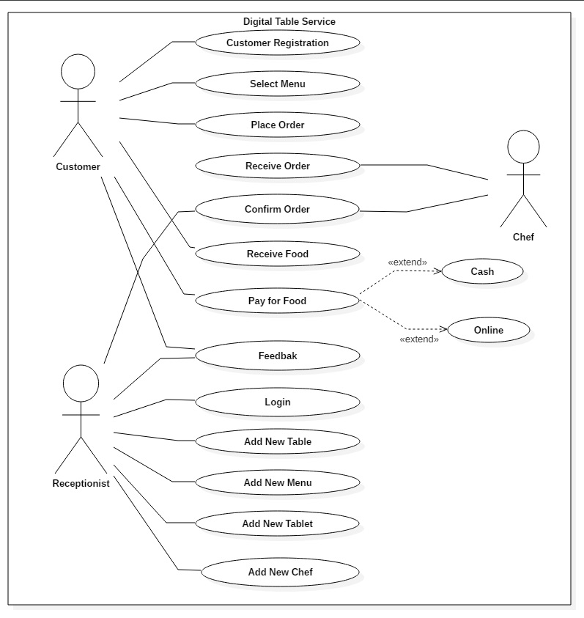
UML Diagram
Use Case :

Slide 4
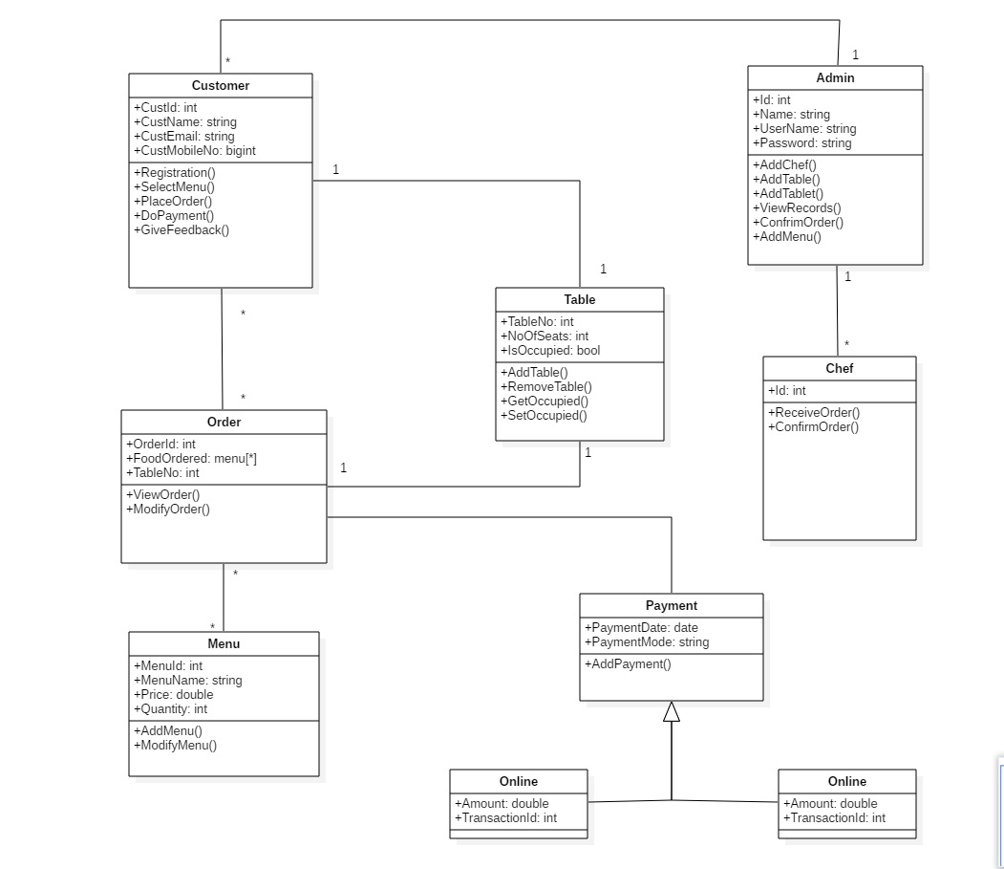
Class Diagram :

Slide 5
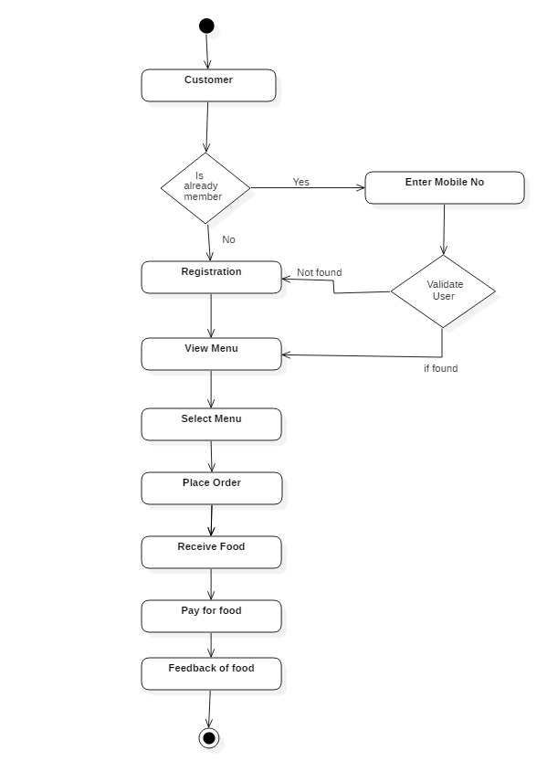
Activity Diagram :
Fig: Customer

Slide 6
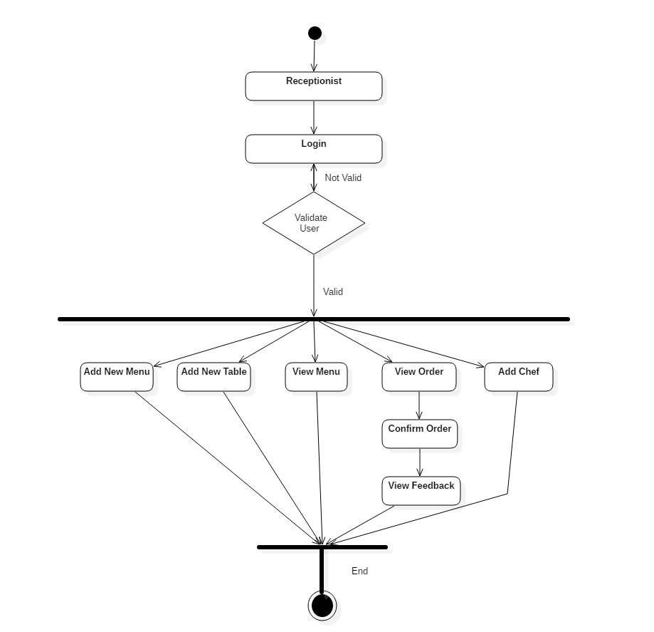
Activity Diagram :
Fig: Receptionist

Slide 7
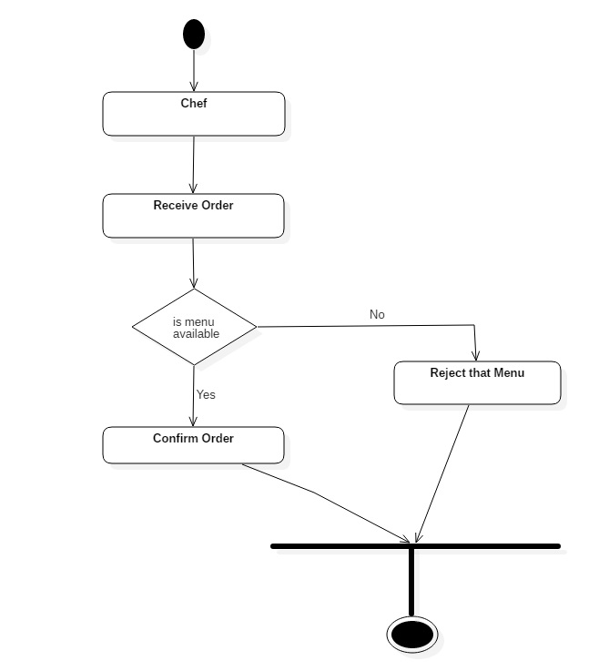
Activity Diagram :
Fig: Chef

Slide 8
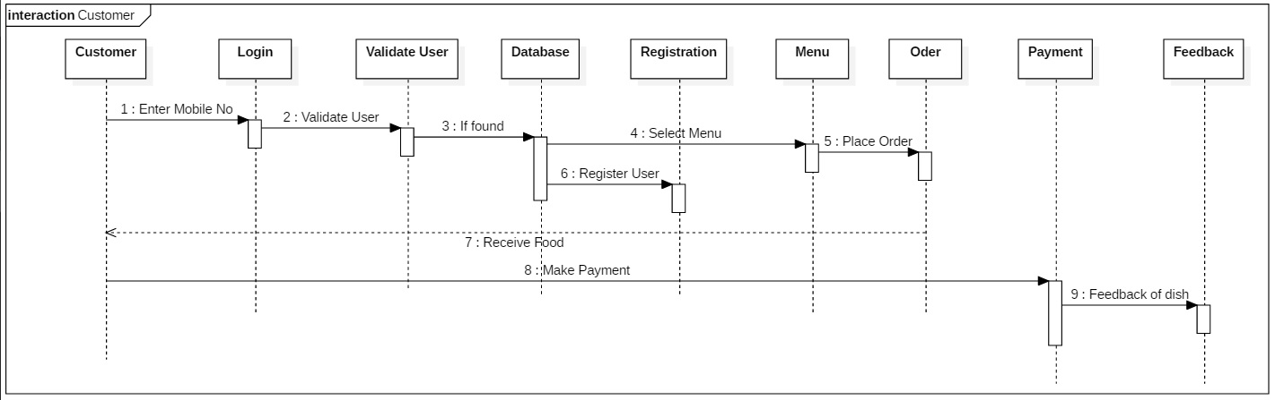
Sequential Diagram :
Fig : Customer

Slide 9
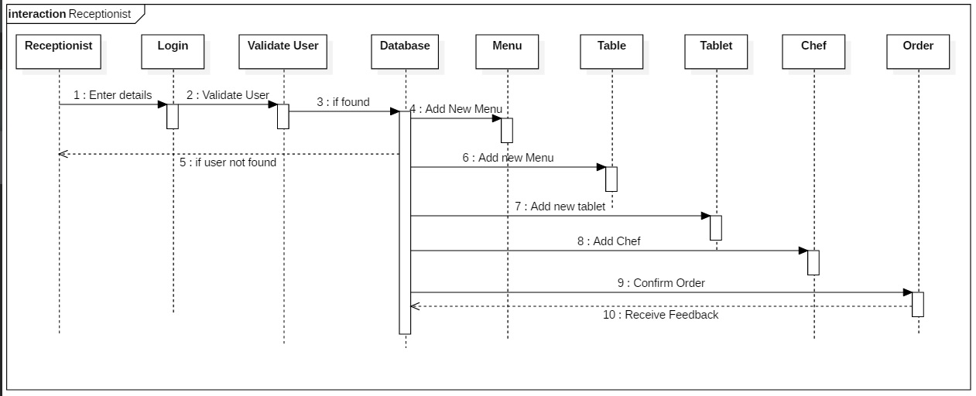
Sequential Diagram :
Fig : Receptionist

Slide 10
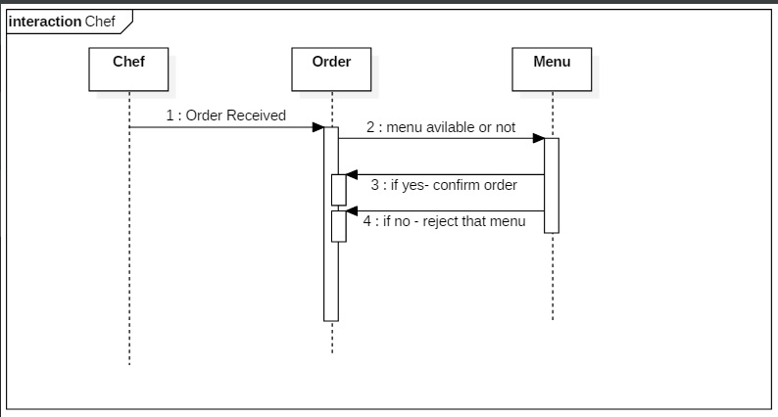
Sequential Diagram :
Fig : Chef

